Slide 1
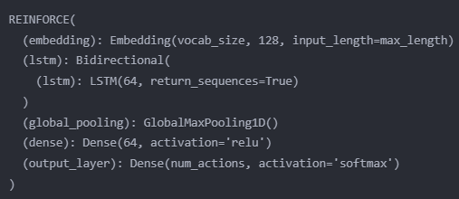
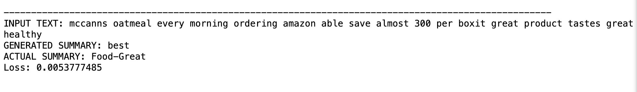
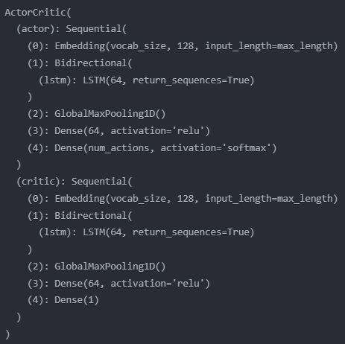
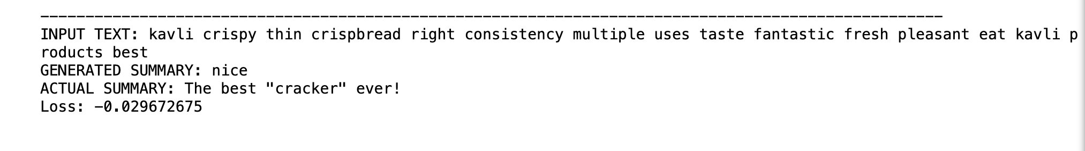
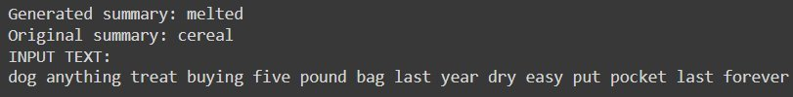

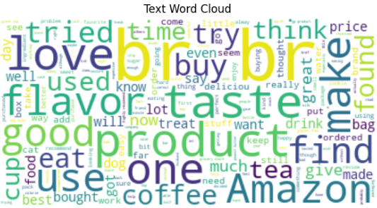
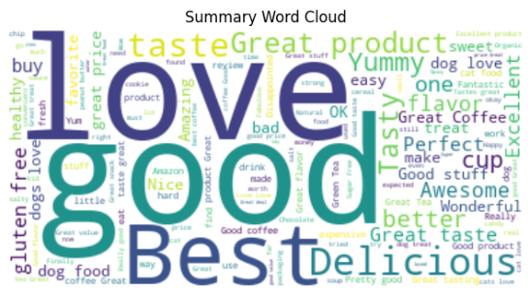
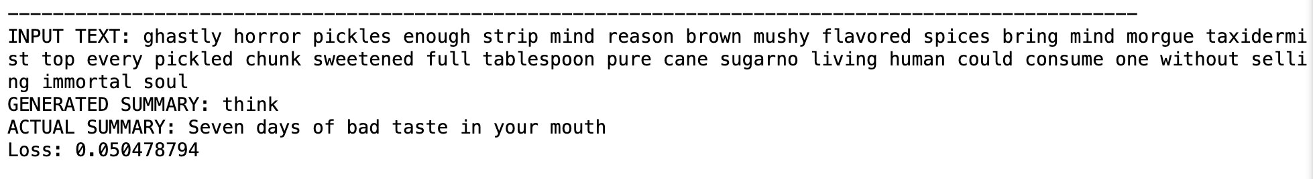
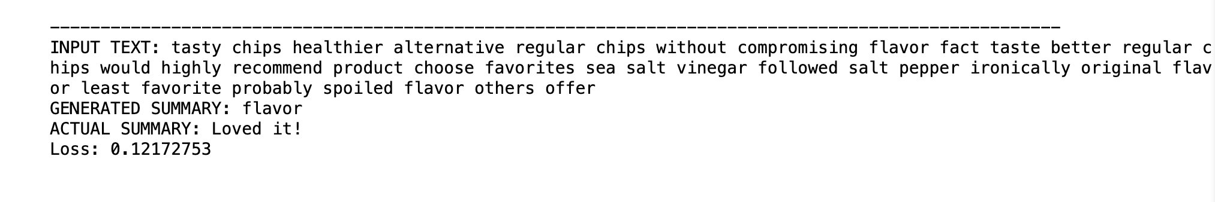

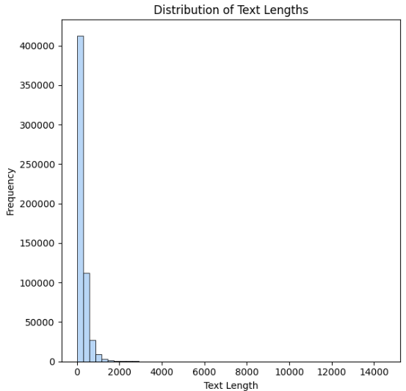
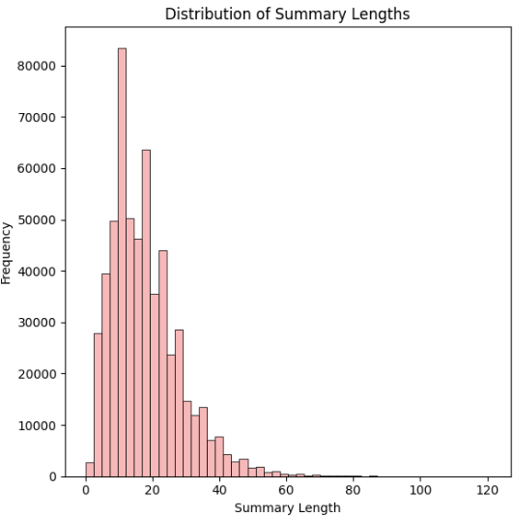

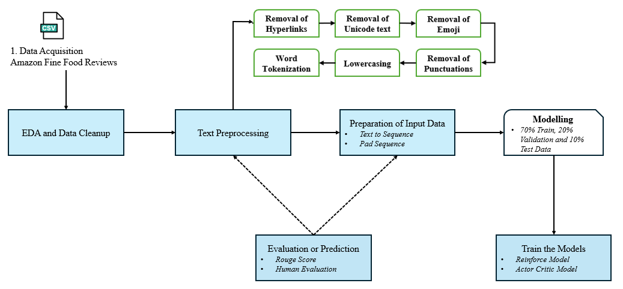
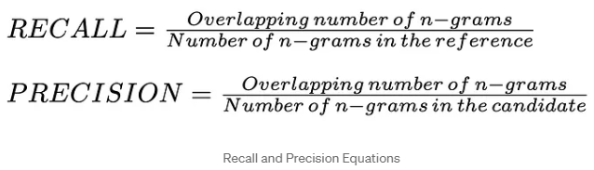
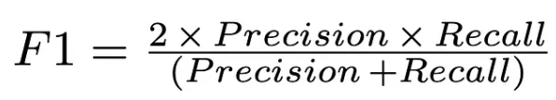
A Reinforcement Learning Approach to Document Summarization
Lasvitha Pregada, Smitha Kannur Ashok, Sneha Venkatapathy
Introduction
Abstractive summarization comprehends the essence of the text and then synthesizes new sentences that capture the core ideas in a condensed and coherent manner.
Combining RL-driven models which refine summarization strategies through trial and error, with deep learning architectures which captures complex dependencies for fluent and accurate summaries leads to highly effective summarization systems
Methods
REINFORCE LEARNING
ACTOR CRITIC
Results
Real Time Applications
News Aggregation: Summarize news articles for up-to-date information without overwhelming details.
Social Media Monitoring: Summarize discussions and trends for public sentiment analysis.
Financial Market Analysis: Analyze market trends and sentiment for timely decision-making.
Customer Support: Summarize queries for quick issue identification.
Live Event Coverage: Summarize events for concise updates and highlights.
Measure of Good Results
Data Analysis
The Amazon fine foods dataset comprises 568,454 reviews from 256,059 users on 74,258 products, with 260 users contributing over 50 reviews each, forming a substantial corpus for training abstractive summarization models.
Word clouds of text and summary highlighting key topics and attributes discussed
Distribution of text and summary lengths provide quantitative insights into the characteristics and quality
Proposed pipeline for the abstractive text summarization
Measure of Bad Results
Conclusion
Our exploration into abstractive text summarization using reinforcement learning, showcases promising avenues for generating concise and informative summaries. Both models offer unique advantages: REINFORCE demonstrates simplicity and effectiveness in policy gradient-based optimization, while the Actor-Critic model leverages the advantages of value function estimation for more stable training and potentially better performance. However, challenges such as reward design and training stability persist, highlighting the need for further research to enhance the efficacy and robustness of these approaches in text summarization tasks. Overall, our study underscores the potential of reinforcement learning techniques in advancing the frontier of abstractive text summarization, with the potential for real-world applications in various domains requiring automated content condensation.
Word cloud of text and summary
Distribution of text and Summary lengths
Environment: Dataset of text documents for summarization.
State: Current context of the summarization task.
Action: Selecting the next word or token to add to the
summary being generated.
Agent: REINFORCE model, Actor Critic Model.
Reward: ROUGE score
Loss: negative log probability, Actor and Critic loss
Returns: Cumulative rewards at each step
Optimizer: Adam optimizer
Challenges
Sparse Rewards: Evaluating summarization quality with metrics like ROUGE may provide limited and delayed feedback, complicating learning.​
Exploration vs. Exploitation: Striking a balance between exploring new strategies and exploiting known ones is crucial yet complex.​
Sample Efficiency: RL algorithms often demand extensive data, challenging in summarization due to the high computational cost.​
Reward Design: Crafting effective reward functions that capture summary quality accurately poses a significant challenge.​
Model Stability: Instabilities during training, such as reward sparsity and vanishing gradients, hinder model convergence.
Generalization: Ensuring learned policies generalize well to new data and diverse tasks remains a demanding task.​
References
Generating Multiple-Length Summaries via Reinforcement Learning for Unsupervised Sentence Summarization - Dongmin Hyun, Xiting Wang, Chanyoung Park, Xing Xie, Hwanjo Yu
A Deep Reinforced Model for Abstractive Summarization - Romain Paulus, Caiming Xiong, Richard Socher
Abstractive text summarization model combining a hierarchical attention mechanism and multiobjective reinforcement learning - Yujia Sun, Jan Platoš
Reinforcement Learning for Abstractive Question Summarization with Question-aware Semantic Rewards - Shweta Yadav∗ , Deepak Gupta∗ , Asma Ben Abacha, Dina Demner-Fushman
Pipeline
Rouge-1 F1 Score
Metric used to evaluate the quality of abstractive text summarization systems by measures the overlap of unigrams between the generated summary and the reference summary.
Department of Computer Science and Engineering
buffalo.edu

